Slide 1
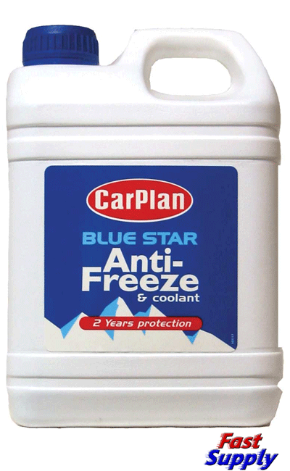
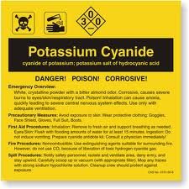
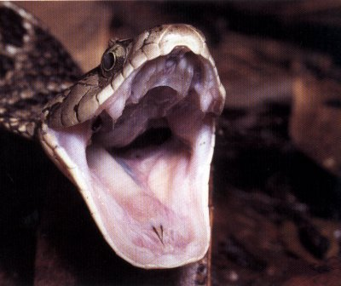
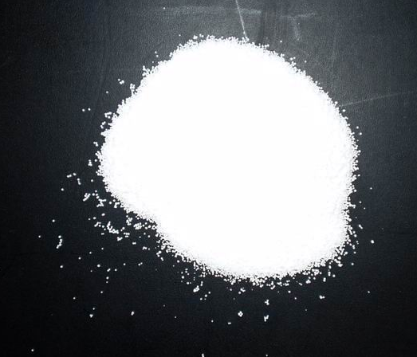
Interfering with enzymes
(poisons and drugs)

Slide 2
Learning outcomes
(g) explain the importance of cofactors and coenzymes in enzyme-controlled reactions
(h) state that metabolic poisons may be enzyme inhibitors, and describe the action of one named poison;
Textbook pp134-139

Slide 3
Deadly poisons
Inhibit or over-activate enzymes
Only 100-200mg of cyanide can kill an adult after about 2hours.
Cyanide is a non competitive inhibitor for the respiratory enzyme cytochrome oxidase.

Slide 4
Ethylene glycol poisoning
Found in anti-freeze
Broken down by the liver by alcohol dehydrogenase producing oxalic acid (very toxic)
Alcohol is a competitive inhibitor to the reaction.
Treatment = massive dose of ethanol; reducing the rate of the reaction allowing the ethylene to be excreted harmlessly.

Slide 5
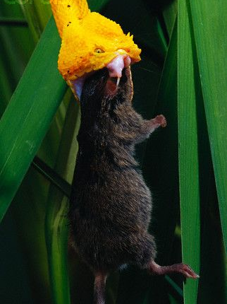
Snake venom
Contains phosphodiesterases – interfere with the workings of the preys heart, causing a fall in blood pressure.
Contains an inhibitor for acetyl cholineesterase (an enzyme involved in nerve transmission)
Contains hyaluronidase – a digestive enzyme that breaks down connective tissue – helps toxins to penetrate tissues quickly

Slide 6
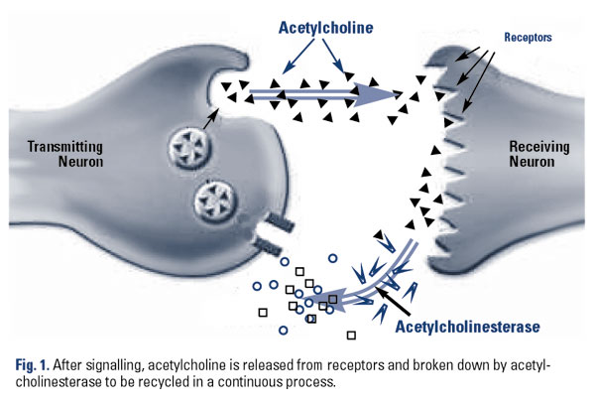

Slide 7
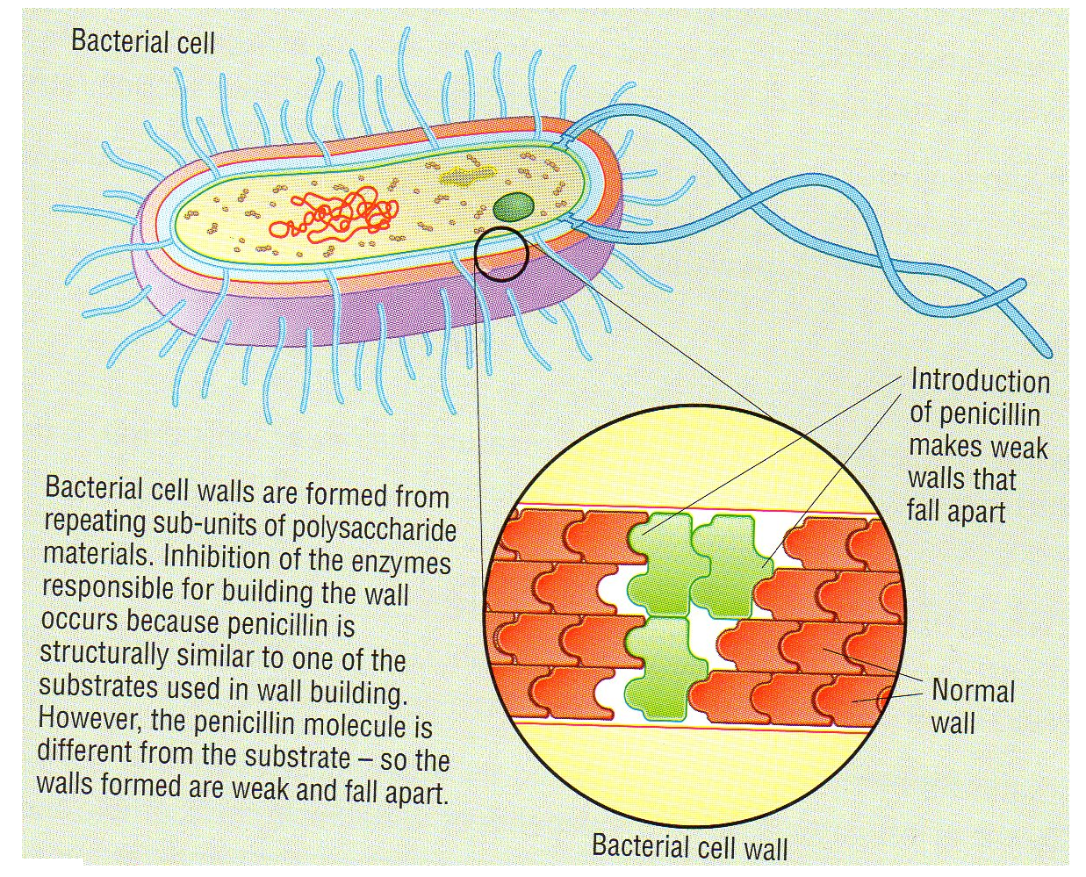
Antibiotics –
Kill or inhibit growth of micro-organisms
Penicillin is an inhibitor of a bacterial enzyme that form cross bridges in the cell wall.
If cell walls are not made, bacterial reproduction is halted.

Slide 8
Some enzymes need help to work – they need something non-protein in order to function
Quite a few vitamins and minerals act as such molecules

Slide 9
Prosthetic groups
What example of a prosthetic group have you already met?
“A non-protein organic molecule that forms a permanent part of a functioning protein molecule.”
E.g. zinc-based prosthetic group in carbonic anhydrase – where have we met this enzyme?

Slide 10
Cofactors
“A molecule or ion that helps an enzyme to work.
It may be an inorganic ion or a coenzyme”

Slide 11
Coenzyme
“An organic non-protein molecule that binds temporarily, with substrate, to an enzyme active site.
It is essential for enzyme activity.”
E.g. Vitamin B3

Slide 12
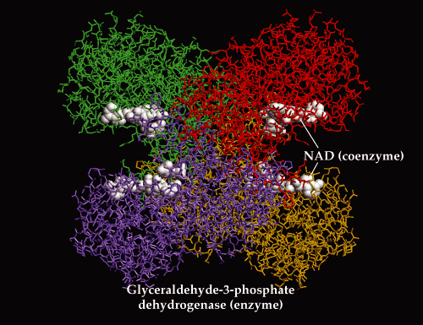

Slide 13
Inorganic ion cofactor
Presence of ion is required for fast reaction
The ion makes the E/S form more readily
e.g. amylase functions properly only if chloride ions are present

Slide 14
