Slide 1
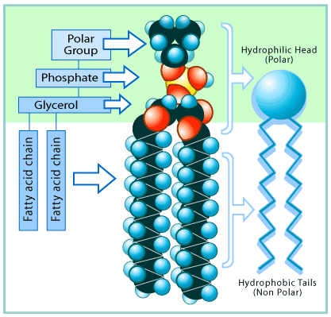
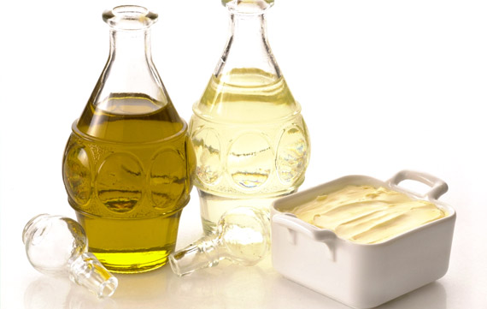
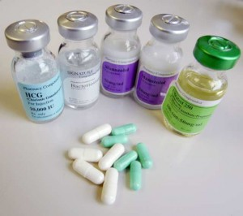
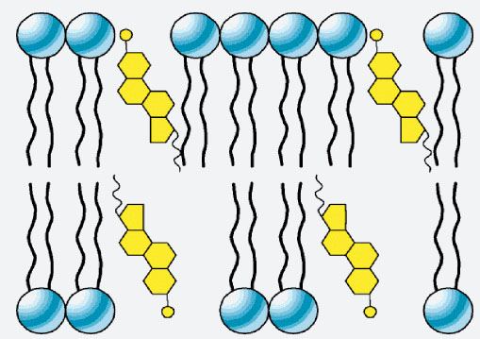
What do these images have in common?
Lipids
Triglycerides – fats and oils
Phospholipids
cholesterol
steroids

Slide 2
Triglycerides – fats and oils
Compare fats and oils:
Solid / liquid at room temperature?
Mainly plant/ animal in origin?
Mainly saturated / unsaturated?
High levels can contribute to cardiovascular disease?
Examples?

Slide 3
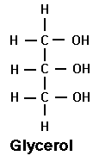
Triglyceride structure
Glycerol + 3 fatty acids ----------> triglyceride + 3water

Slide 4
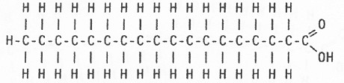
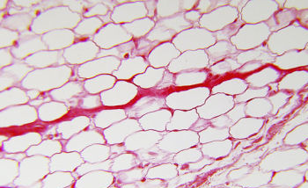
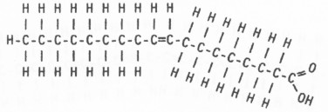
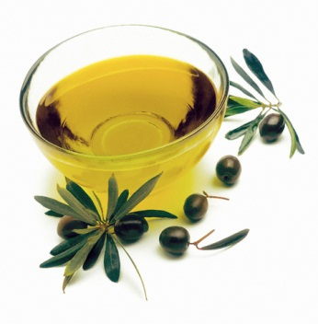
Triglyceride structure
Glycerol + 3 fatty acids ----------> triglyceride + 3water
Fatty acids
Stearic acid
in adipose tissue
Acid group
(carboxylic acid group)
Oleic acid
in olive oil

Slide 5
List differences between these fatty acids:
Double bonds present between carbon atoms?
Fewer hydrogen atoms bonded to the molecule
Kinked chain?
Saturated or unsaturated?
Feature of a poor diet?
Stearic acid
Oleic acid

Slide 6
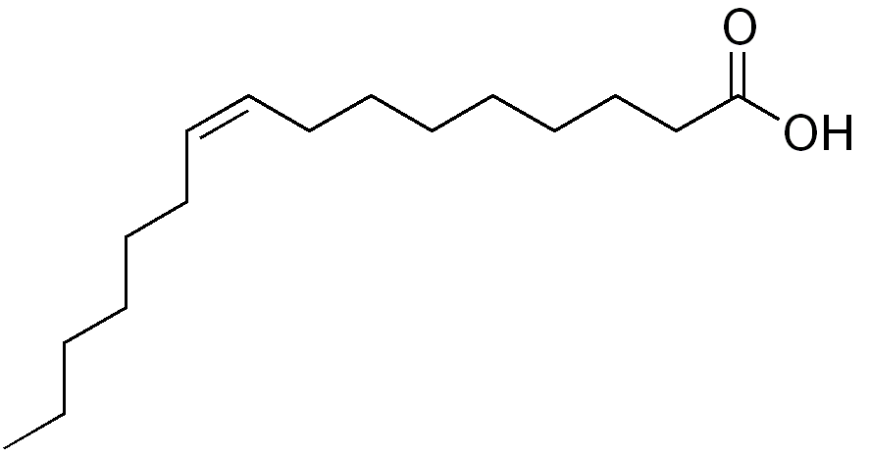

Saturated or unsaturated fatty acid?

Slide 7
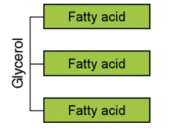
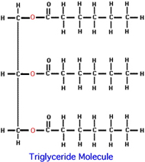
Triglyceride
One glycerol molecule attached to three fatty acid molecules
glycerol
3 fatty acids
Ester bond
What type of reaction forms an ester bond?
What type of reaction breaks an ester bond?
What type of bond is an ester bond?
How many water molecules will be released during the formation of one triglyceride?

Slide 8
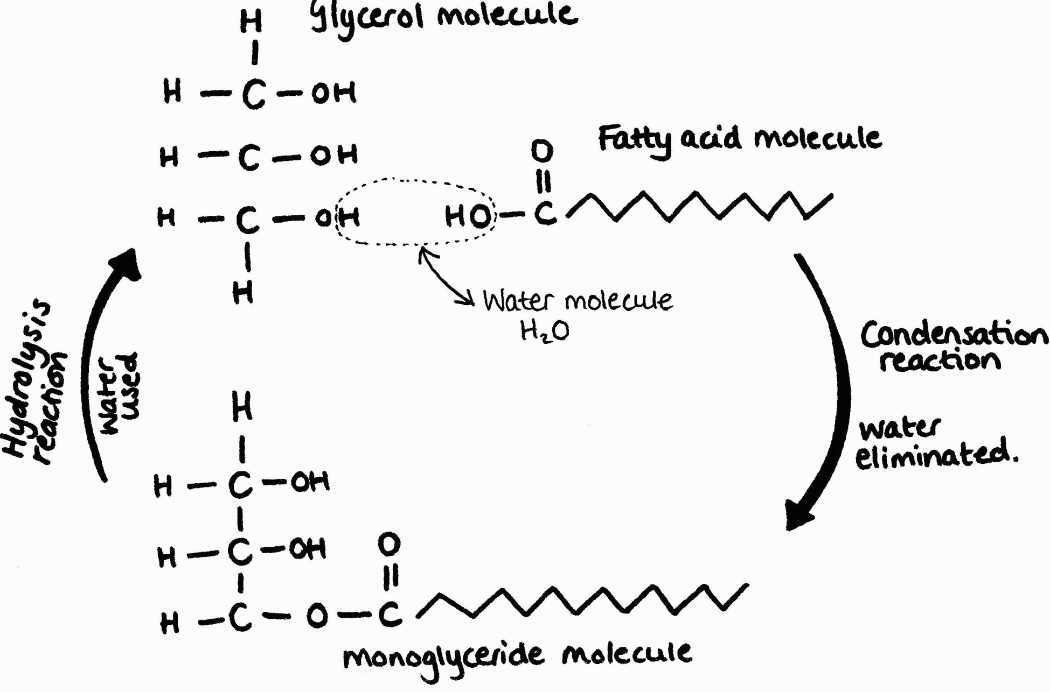

Formation of ester bonds
Formation of ester bond is similar to glycosidic as it expels water, but different as it joins two different sub units together

Slide 9
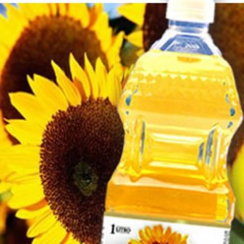
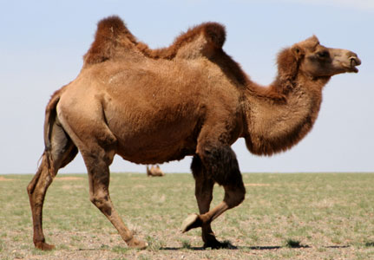
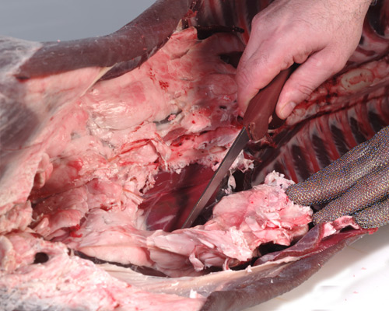
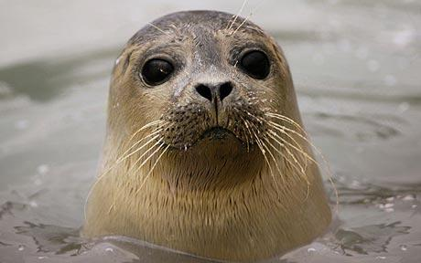
Roles of triglycerides in living organisms
Suggest a property of triglycerides relating to each role and give an example
Energy store
Thermal insulation
Buoyancy
Protection-internal organs
Source of water when respired

Slide 10
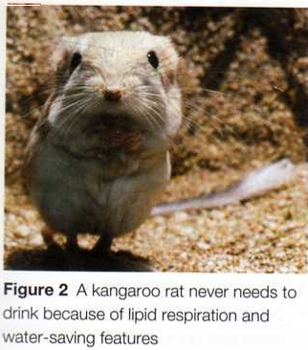
Lipids and respiration
Hydrolysis of ester bonds first.
Glycerol and fatty acids broken
down completely to carbon
dioxide and water.
Releases energy to make ATP
1g lipid releases twice as much energy as the respiration of 1g carbohydrate.

Slide 11
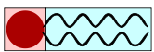
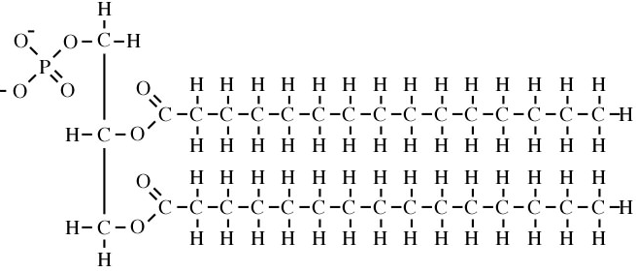
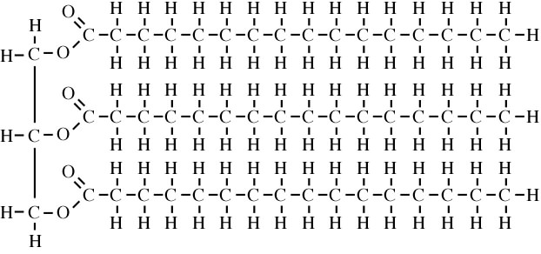
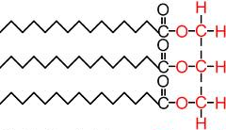
Phospholipids list the differences between a phospholipid and triglyceride molecules:
Key words: hydrophobic, hydrophilic, polar, non-polar, fatty acid ‘tails’, glycerol/phosphate ‘head’, ester bond

Slide 12
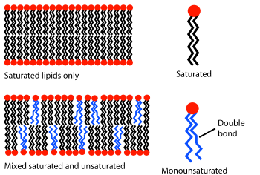
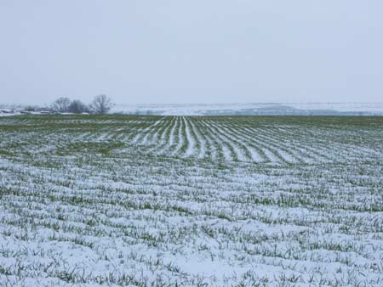

Suggest the advantage of having unsaturated fatty acids in membrane phospholipid bilayers for some organisms

Slide 13
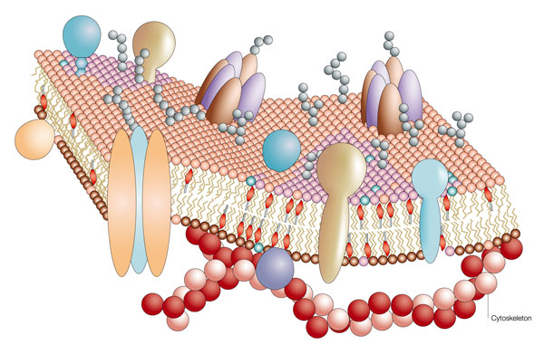
Function of phospholipids?

Slide 14
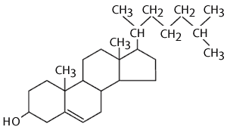
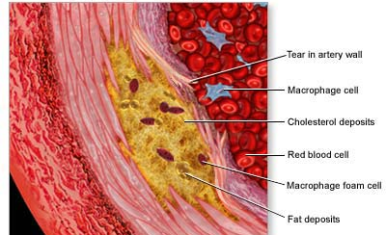
Cholesterol
Not glycerol + fatty acids
Small, narrow molecule
4 carbon based ring structures
Role:
Regulates fluidity of membranes
Suggest how the structure of cholesterol relates to its role
Why is high blood cholesterol a danger to health?

Slide 15
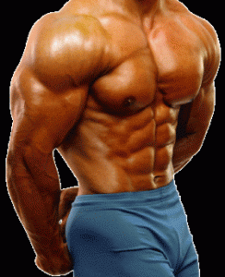
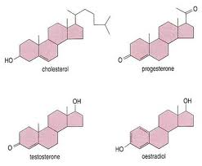
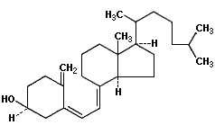
Steroids – made from cholesterol
Some hormones eg testosterone, oestrogen
Vitamin D
Suggest why these molecules pass into cells easily
Suggest why Vitamin D can be stored by humans but Vitamin C cannot
Vitamin D

